Slide 1

INTERNSHIP PERFORMANCE REPORT
TWO
MONTHS.
ONE
INTERN.
MANY
ROLES.
INTERN-
SHIP
REPORT
Content · Ads · Production · Strategy
13+ Industries · 25+ Scripts · 25+ Videos
FEB 19 – APR 30, 2026 · HASHTAG AGENCY · PANCHKULA
30+
56
1K+
1.8M
BRANDS
DAYS
LEADS
VIEWS
Notes:
1

Slide 2
PEHLE FORMAL REPORT
(Data is based on daily tracking and documenting I did in Notion)

Slide 3
01
Ek Chhota sa Glance
30+
56
13+
2
Brands Touched
Working Days
Industries
Cities
1,014+
10+
25+
25+
Total Leads
Campaigns Run
Scripts Written
On-Camera Videos
Notes:
2

Slide 4
02
I ALWAYS UPSCALE (MONTH 1 VS MONTH 2)
MONTH 1 — DAYS 1–28
MONTH 2 — DAYS 29–56
Brands
24
Brands
34+ ↑
Ads Days
16
Ads Days
25 ↑
Shoot Days
13
Shoot Days
20 ↑
Script Days
14
Script Days
14 →
Correction Days
7
Correction Days
3 ↓
Cities
1
Cities
2 ↑
On-Camera Videos
~5
On-Camera Videos
20+ ↑
1M+ Views Reel
—
1M+ Views Reel
1 ✦
Notes:
5

Slide 5
03
META ADS CAMPAIGN RESULTS (thanks to Deepika Ma'am)
BRAND
INDUSTRY
LEADS
REACH
CPL
SPEND
Garg Autos — Ad 1
Automotive
197
92,356
₹26.52 ✓
₹5,224
Garg Autos — Ad 2
Automotive
98
71,322
₹53.12
₹5,205
Garg Autos — Ad 3
Automotive
77
64,837
₹66.51
₹5,121
(p.s. the timeline of these ads are around monthly basis and there were more ads which were closed, these ads were put by me under deepika ma'am's guidance)
Elevate — A/B Test A
Fitness
190
1,33,948
₹28.48 ✓
₹5,411
Elevate — A/B Test B
Fitness
161
1,29,855
₹33.70
₹5,425
Raj Assured
2nd Hand Auto
83
18,795
₹25.53 ✓
₹2,121
Skywize Aviation
Education
69
22,588
₹49.00
₹3,394
Hashtag Agency
Marketing
49
28,984
₹39.00
₹1,959
JK Bhasin Realty
Real Estate
54
10,831
₹55.00
₹2,998
TOTAL
1,014+ LEADS
5.88L REACH
~₹40 CPL
₹40,374+
While I focused on lead generation efficiency, I aim to further deepen my understanding of lead qualification and conversion tracking.
Notes:
3

Slide 6
04
WHY I SHOULD BE AN EX INTERN AND FRESH EMPLOYEE
🔥
1.8M+ Views Reel
⚡
8 Scripts in 1 Day
You knew this was coming hehe
Created and got approved in a single day
🎬
10+ Videos on 1hr Sleep
🤝
Client Called Me A Star
1 hour sleep, 1 parantha andar, Yaar Dharmendar
Skywize appreciated me and i was on cloud 9
🧠
Scripting with Least AI
👥
Whole Office Admires me
Ai should buy my membership
Drunk talks you know, you know 🤫
📍
4 Seniors' Work Handled
🎯
Shoot Efficiency
Did Work Under 4 मासियां
Power to remove filler words and make the shoot cut to cut clear so that i can enjoy Anoop's tea carefree
📸
Front & Back of Camera
✍️
10-Min Scratch Script
Good camera confidence along with behind the camera help
Prepared that scoopwonder script faster than blinkit's order
Notes:
7

Slide 7
05
The Brands i Touched
AMPM
Winsolar
Skywize
Classic Furniture
Meibotan
Hashtag
Onfinity
Benu Rao
BDG Group
Bansal Plaza
Garg Autos
Kare Partners
Elevate
Unicom
KFC
Neeilam
City Wanderer
JK Bhasin Realty
TSAR Capital
Vinfast
Keaa
Raj Assured
Achievers Castle
Rayat Bahra Uni
Mortgage by Monga
DigiKard
LearnUp
Scoopwonder
Cremyo
Wilwin
Kali Coffee
LG
MyBodyBox
Notes:
8

Slide 8
06
MY TOP BRANDS ALONG WITH MY TOP TASKS
CONTENT
1. Hashtag
2. Digikard
3. AMPM
4. Skywize
5. Garg Autos
6. Mortgage by Monga
7. Scoopwonder
8. Kali Coffee
9. Cremyo
10. Mybodybox
11. Raj Assured
12. Meibotan
ADS
1. Skywize
2. Garg Autos
3. Elevate
4. Winsolar
5. Vinfast
6.Raj Assured
7. JK Bhasin
8. Wilwin
9. Hashtag
SCRIPTS
1. JK Bhasin
2. Skywize
3. Hashtag
4. Raj Assured
5. Achievers Castle
6. Digikard
7. Scoopwonder
8. Cremyo
9. Mybodybox

Slide 9
CASE STUDY 01 · CONTENT PRODUCTION
25+ VIDEOS. 10+ BRANDS
Talking Head · UGC · On-Camera Talent · DOP
25+
10+
1.8M+
2
Videos Produced
Brands
Views — Top Reel
Cities
WHAT I DID
RESULTS
Took on dual role of on-camera talent and DOP simultaneously. Scripted the content, directed the shots, and delivered same day across brands. Most intensive: full production day in Gurgaon on 1 hour of sleep and 10+ videos delivered.
→
1.8M+ views on single reel — solo written, directed & performed
→
200+ followers gained from one organic piece
→
10+ videos in a single out-of-station production day
→
UGC + Talking Head formats across all 10+ Brands
BRANDS
Skywize
Scoopwonder
Garg Autos
Hashtag
DigiKard
Kali Coffee
AMPM
Cremyo
& More
🎬
"I don't just show up on camera. I script it, direct it, and deliver it. Same day, under pressure, across any brand."
Notes:
1

Slide 10
CASE STUDY 02 · META ADS MANAGEMENT
1,014+ LEADS. ₹40,374 MANAGED.
Lead Gen · A/B Testing · Pipeline Tracking · Daily Ops · 10+ Live Campaigns
1,014+
10+
~₹40
71%
Total Leads
Campaigns
Blended CPL
CPL Reduction
WHAT I DID
RESULTS
Managed 10+ live campaigns across 5 industries simultaneously. Updated lead sheets daily, ran A/B tests on creatives, and optimized continuously. Daily ops for 8–12 brands by Month 2.
→
₹25.53 CPL- best performer, Raj Assured
→
372 leads for Garg Autos across 3 campaigns
→
71% CPL drop for Elevate, ₹97 → ₹28 via A/B test
→
387 leads for Elevate in total
BRANDS
Garg Autos
Elevate
Raj Assured
Skywize
JK Bhasin
Hashtag
Vinfast
Winsolar
& More
📊
"I don't just run ads. I track, optimize, and deliver results.
Notes:
2

Slide 11
07
Value I Provided
• I delivered efficiently at Intern Level
• I reduce cost by handling multiple roles
• Reduced dependency on senior team by handling multiple tasks
• Can manage Content, Meta Ads and Scriptwriting
• Worked across multiple industries
• Communicate with Clients easily
• Fit into many roles while shooting content

Slide 12
08
What changes if I go full-time
  Increase content output
  Better learning and execution for Meta and Google Ads
  Can take ownership of Clients
  Better Ideation and faster Execution
  Will be helpful in onboarding for international clients
  Experimenting with new creative ideas
  Reduce workload on senior team members

Slide 13
MERA परिश्रम

Slide 14
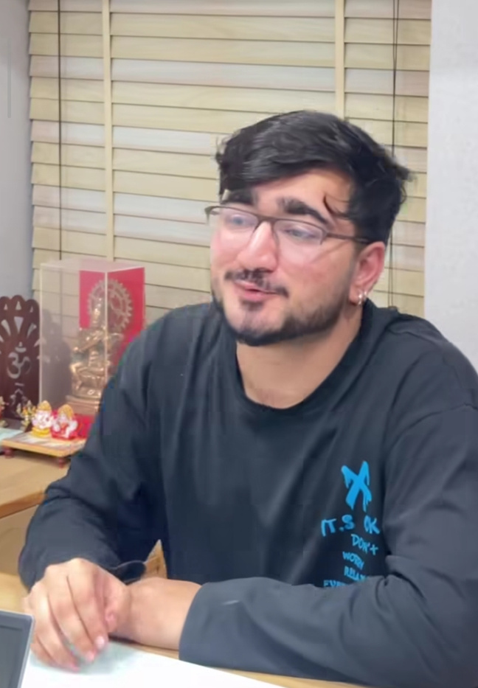
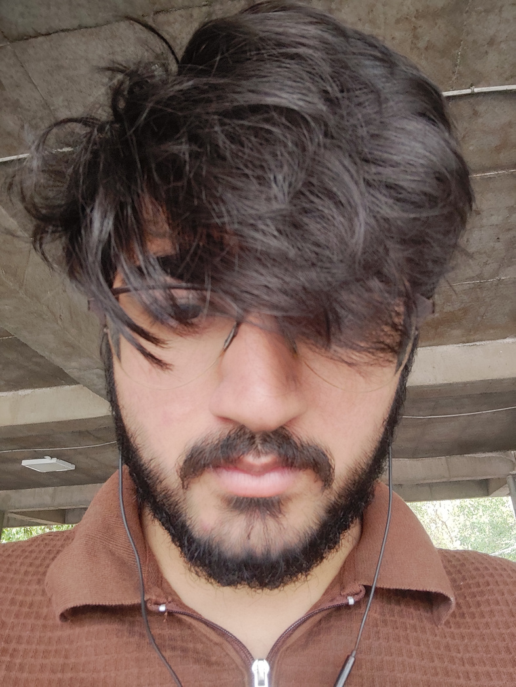
Day 1 of Internship
Day 60 of Internship
(itni मेहनत ki haircut ka time नहीं mila)

Slide 15
MERA SWOT ANALYSIS
MY STRENGTH
MY WEAKNESS
My Glorious Mind
Nothing (jk, content calendars maybe)
MY OPPORTUNITY
MY THREATS
Ek badiya F&B wala client 🍽️
खाली पेट काम

Slide 16

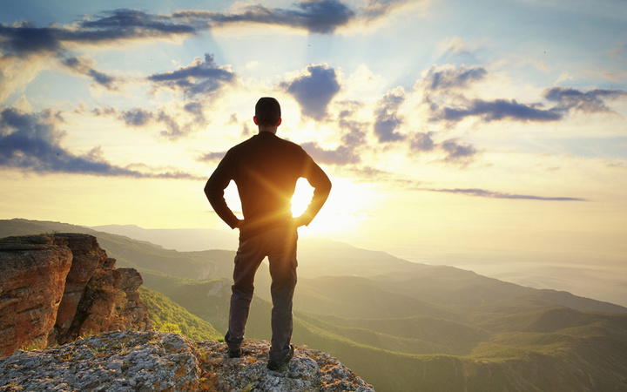
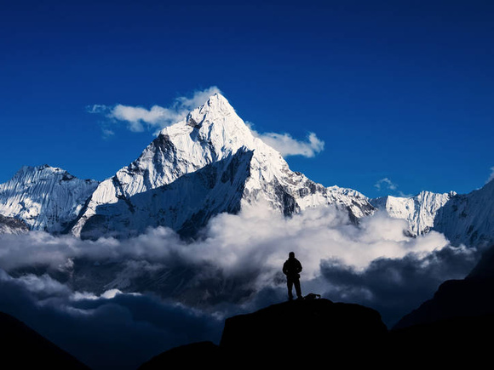
What Will Happen if i get paid more
I will be Happy
You will see more better work from my side
Hashtag will be at peak

Slide 17
So based on the data you should bless me with

Slide 18
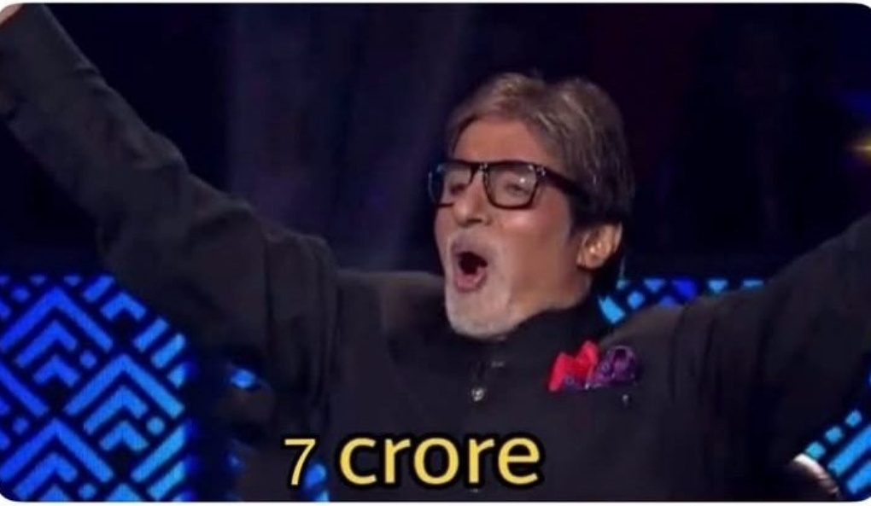

Slide 19
Just Kidding...

Slide 20

BUT STILL
Salary Badha do Saheb
because...

Slide 21

2 months. 30+ brands. 15+ Tasks.
In this internship I didn't just execute tasks, I owned outcomes. From writing 12 scripts for a single real estate client to producing a 1.8M+ views reel and on-camera talent
every deliverable was built on raw creative output with minimal AI involvement.
Majority Hard Skills Proven:
Meta Ads Management · Scriptwriting · Content Production · Talking Head & UGC Videos
Soft Skills Demonstrated:
Performance under pressure · Creative problem solving · Speed without compromising quality · Adaptability across 13 industries · Ownership mentality · Team support across 4 seniors
By the numbers:
25+ on-camera videos · 25+ scripts · 10+ campaigns
I didn't come here to complete an internship. I came to prove what I'm worth.

Slide 22
THANKYOU

